Slide 1
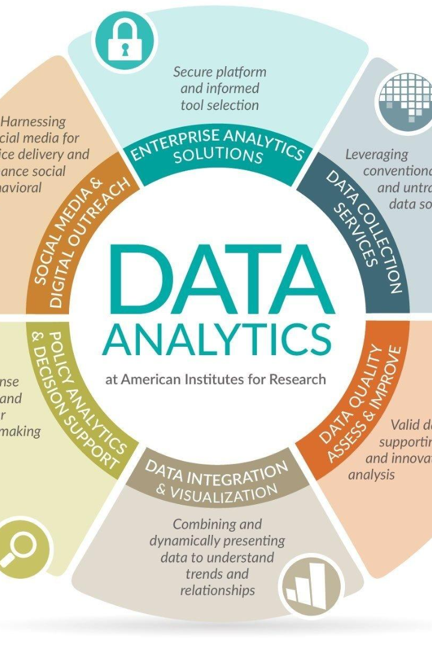

Product Sales Analysis
Welcome to this presentation on product sales analysis. In this deck, we will explore visualizing data in IBM Cognos, data loading, cleansing, and preprocessing in Jupyter Notebook using Python.

Slide 2
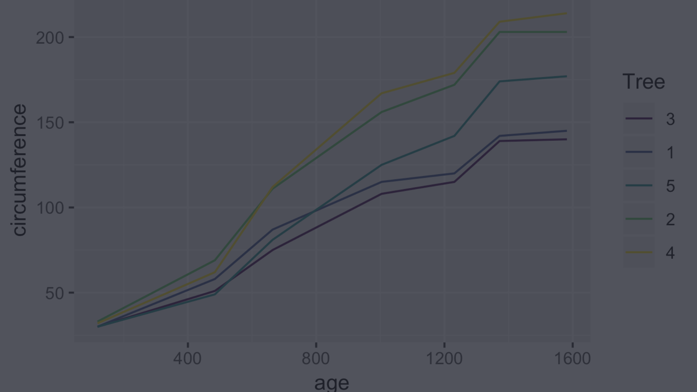
Understanding Sales Trends
1
Region-Wise Sales
Explore sales by region to identify trends and patterns.
Product Sales
2
Analyze sales of individual products to identify top-selling items.
3
Yearly Sales
Examine sales over the years to identify growth or decline in different regions and products.

Slide 3
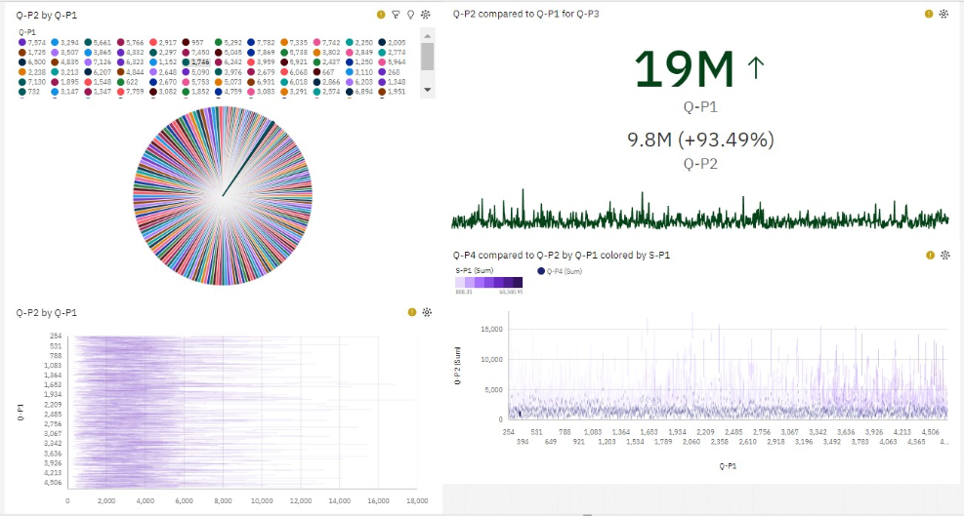
Visualizing Data in IBM Cognos
Dashboard Creation:
Dashboard creation involves designing visual interfaces that display data in a concise and user-friendly manner. These dashboards are widely used in various fields, including business, data analytics, and information technology.

Slide 4
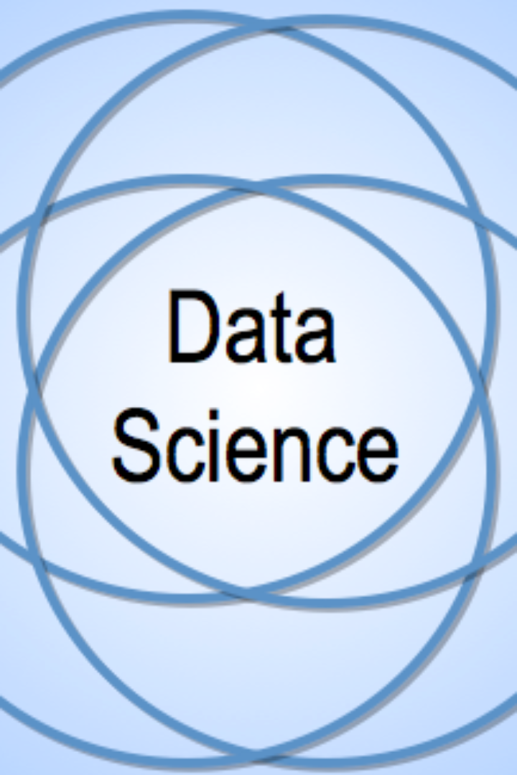
Data Science
Data science in Python involves using the Python programming language and various libraries and tools to analyze, manipulate, visualize, and make predictions from data. It is a multidisciplinary field that combines techniques from statistics, computer science, and domain-specific knowledge to extract insights and value from data.

Slide 5
Data Loading and Preprocessing
Data Loading and Integration
Data Preprocessing Techniques
Data Cleaning
Work with data cleaning techniques, including dealing with missing values and outliers, to produce accurate and reliable data outputs.
Load multiple data sources from varying formats such as CSV, Excel, and them for easy analysis.
Explore data reformatting techniques, including value encoding and feature scaling, to prepare data for advanced analysis.

Slide 6
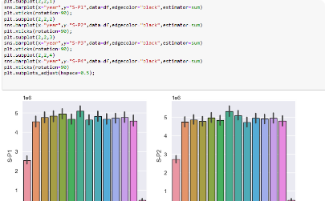
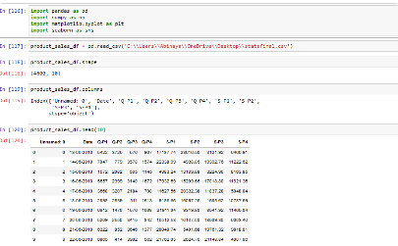
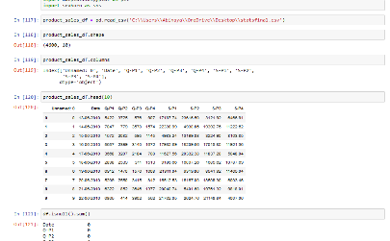
Data Cleansing in Jupyter Notebook
Intuitive Interface
Python-Based Scripts
Data Processing Code
Use a user-friendly interface to access powerful data manipulation capabilities.
Use Python-based scripts to load, manipulate, and analyze data for easy interpretation.
Address issues within code or scripts with efficient debugging options.

Slide 7
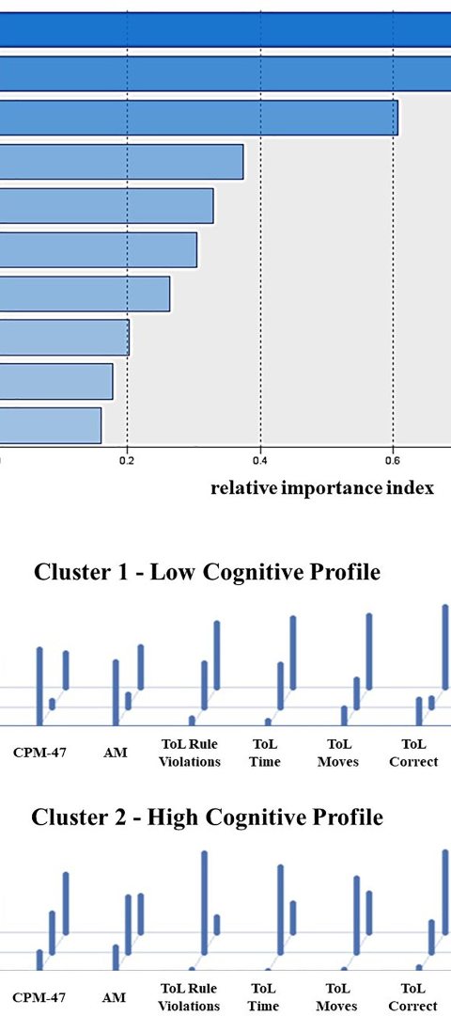
Cluster Analysis
1
Hierarchical Clustering
Use hierarchical clustering for visualizing the similarity and relationship between different data points.
2
K-Means Clustering
Use the K-means clustering technique to group unstructured data into meaningful patterns and categories.
3
Cluster Interpretation
Understand, interpret, and use results of cluster analysis to identify patterns and trends in the data.

Slide 8
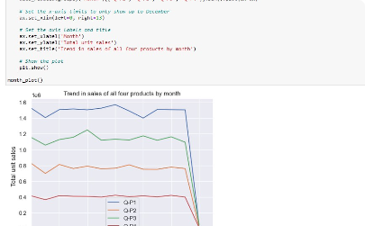
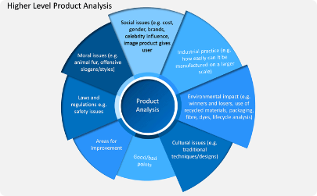
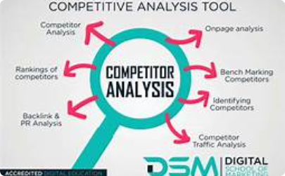
Advanced Data Visualization Techniques
Scatterplot Charts
Product analysis
Competitor Analysis
Use scatterplots to analyze the relationship between different variables and identify trends and patterns.
Evaluating the performance of different products or services, including their popularity, profitability, and customer satisfaction.
Understanding what your competitors are doing in terms of sales strategies, pricing, and customer acquisition.

Slide 9
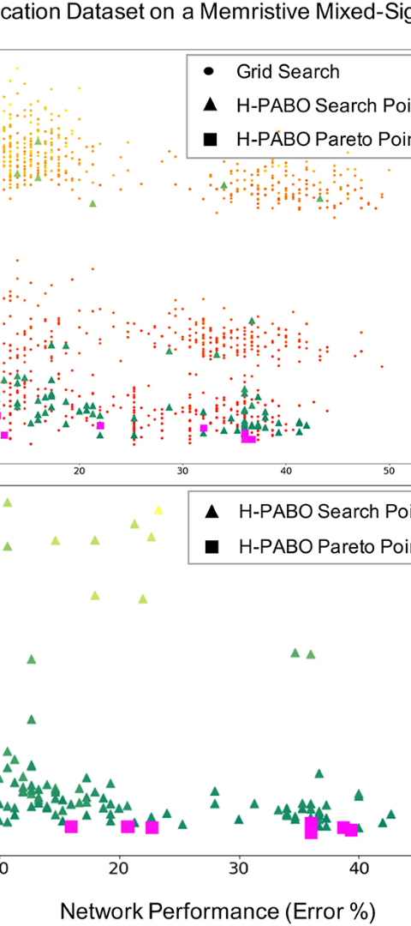
Hyper Parameter Tuning
1
GridSearchCV
Use GridSearchCV to find the optimal combination of hyperparameters for a machine learning model.
2
RandomizedSearchCV
Use RandomizedSearchCV to identify the optimal hyperparameter combinations in a shorter amount of time.
3
Bayesian Optimization
Use Bayesian optimization to optimize hyperparameters efficiently, especially for complex models, while reducing computation time and resources.

Slide 10
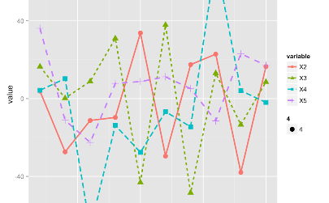
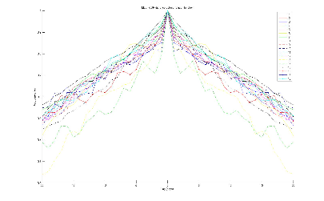
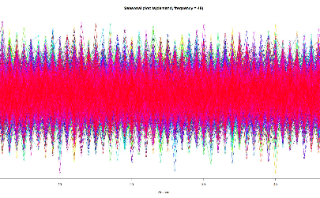
Time Series Analysis
Line Charts
Autocorrelation Plots
Seasonal Subseries Plots
Use line charts to represent data trends over time and to identify the time series models based on data patterns.
Use autocorrelation plots to identify patterns and trends in time series data and select methods to cope with these patterns, including differencing and smoothing.
Use seasonal subseries plots to analyze seasonal patterns and to identify the different components of a time series, including trend, seasonality, and errors.

Slide 11

Conclusion
1
Visualize Data Effectively
2
Preprocessing Makes a Difference
3
Advanced Techniques for Accurate Results
Use different data visualization techniques, including charts, graphs, and maps, to represent the data and identify patterns and trends.
Cleansing, loading, and preprocessing the data is essential for accurate and meaningful data analysis.
Cluster analysis, hyperparameter tuning, and time series analysis are advanced techniques that can provide accurate and reliable data insights.

